Slide 1
Clustering

Slide 2
What is Cluster Analysis?
Finding groups of objects such that the objects in a group will be similar (or related) to one another and different from (or unrelated to) the objects in other groups
Inter-cluster distances are maximized
Intra-cluster distances are minimized

Slide 3
What is Cluster Analysis?
Cluster: a collection of data objects
Similar to one another within the same cluster
Dissimilar to the objects in other clusters
Cluster analysis
Grouping a set of data objects into clusters
Clustering is unsupervised classification: no predefined classes
Clustering is used:
As a stand-alone tool to get insight into data distribution
Visualization of clusters may unveil important information
As a preprocessing step for other algorithms
Efficient indexing or compression often relies on clustering

Slide 4
Clustering
Clustering of data is a method by which large sets of data is grouped into clusters of smaller sets of similar data
Objects in one cluster have high similarity to each other and are dissimilar to objects in other clusters
Group objects that share common characteristics

Slide 5
Some Applications of Clustering
Pattern Recognition
Image Processing
cluster images based on their visual content
Bio-informatics
WWW and IR
document classification
cluster Weblog data to discover groups of similar access patterns

Slide 6
Clustering Applications
Segment customer database based on similar buying patterns.
Group houses in a town into neighborhoods based on similar features.
Identify new plant species
Identify similar Web usage patterns

Slide 7
Clustering Applications
Marketing: Help marketers discover distinct groups in their customer bases, and then use this knowledge to develop targeted marketing programs
Land use: Identification of areas of similar land use in an earth observation database
Insurance: Identifying groups of motor insurance policy holders with a high average claim cost
City-planning: Identifying groups of houses according to their house type, value, and geographical location
Earth-quake studies: Observed earth quake epicenters should be clustered along continent faults

Slide 8
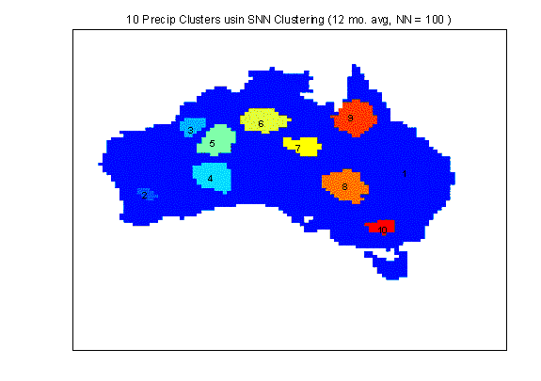
Applications of Cluster Analysis
Understanding
Group related documents for browsing, group genes and proteins that have similar functionality, or group stocks with similar price fluctuations
Summarization
Reduce the size of large data sets
Clustering precipitation in Australia

Slide 9
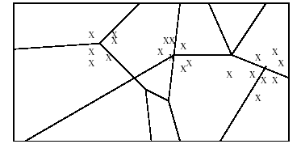
Applications of Cluster Analysis
Many years ago, during a cholera outbreak in London, a physician plotted the location of cases on a map, getting a plot that looked like Fig. below. Properly visualized, the data indicated that cases clustered around certain intersections, where there were polluted wells, not only exposing the cause of cholera, but indicating what to do about the problem. Alas, not all data mining is this easy, often because the clusters are in so many dimensions that visualization is very hard.

Slide 10
Applications of Cluster Analysis
Skycat clustered 2x10⁹ sky objects into stars, galaxies, quasars, etc. Each object was a point in a space of 7 dimensions, with each dimension representing radiation in one band of the spectrum. The Sloan Sky Survey is a more ambitious attempt to catalog and cluster the entire visible universe.
Documents may be thought of as points in a high-dimensional space, where each dimension corresponds to one possible word. The position of a document in a dimension is the number of times the word occurs in the document (or just 1 if it occurs, 0 if not). Clusters of documents in this space often correspond to groups of documents on the same topic.

Slide 11
What is not Cluster Analysis?
Supervised classification
Have class label information
Simple segmentation
Dividing students into different registration groups alphabetically, by last name
Graph partitioning
Some mutual relevance and synergy, but areas are not identical

Slide 12
Notion of a Cluster can be Ambiguous
How many clusters?
Six Clusters
Two Clusters
Four Clusters

Slide 13
Clustering vs. Classification
No prior knowledge
Number of clusters
Meaning/interpretation of clusters
Unsupervised learning

Slide 14
Types of Clustering
A clustering is a set of clusters
Important distinction between hierarchical and partitional sets of clusters
Partitional Clustering
A division data objects into non-overlapping subsets (clusters) such that each data object is in exactly one subset
Hierarchical clustering
A set of nested clusters organized as a hierarchical tree

Slide 15
Clustering Approaches
Clustering
Hierarchical
Partitional
Density-based
Grid-based

Slide 16
Partitional Clustering
Original Points
A Partitional Clustering

Slide 17
Hierarchical Clustering
Traditional Hierarchical Clustering
Traditional Dendrogram
Non-traditional Hierarchical Clustering
Non-traditional Dendrogram

Slide 18
Hierarchical Methods
Creates a hierarchical decomposition of a given set of data objects
Agglomerative
Initially each item in its own cluster
Clusters are merged iteratively
Bottom up
Divisive
Initially all items in one cluster
Large clusters are divided successively
Top down

Slide 19
Hierarchical Clustering
Step 0
Step 1
Step 2
Step 3
Step 4
agglomerative
(AGNES)
a
a b
b
a b c d e
c
c d e
d
d e
e
divisive
(DIANA)
Step 4
Step 3
Step 2
Step 1
Step 0

Slide 20
Hierarchical Clustering
Produces a set of nested clusters organized as a hierarchical tree
Can be visualized as a “dendrogram”
A tree like diagram that records the sequences of merges or splits

Slide 21
Density-based Methods
Most partitioning-based methods cluster objects based on distances between them
Can find only spherical-shaped clusters
Density-based clustering
Continue growing a given cluster as long as the density in the ‘neighborhood’ exceeds some threshold.

Slide 22
Other Distinctions Between Sets of Clusters
Exclusive versus non-exclusive
In non-exclusive clusterings, points may belong to multiple clusters.
Can represent multiple classes or ‘border’ points
Fuzzy versus non-fuzzy
In fuzzy clustering, a point belongs to every cluster with some weight between 0 and 1
Weights must sum to 1
Probabilistic clustering has similar characteristics
Partial versus complete
In some cases, we only want to cluster some of the data
Heterogeneous versus homogeneous
Cluster of widely different sizes, shapes, and densities

Slide 23
Partitioning Algorithms:
Basic Concept
Partitioning method: Construct a partition of a database D of n objects into a set of k clusters
Given a k, find a partition of k clusters that optimizes the chosen partitioning criterion
Global optimal: exhaustively enumerate all partitions
Heuristic methods: k-means and k-medoids algorithms
k-means (MacQueen’67): Each cluster is represented by the center of the cluster (mean value of objects in the cluster)
k-medoids or PAM (Partition around medoids) (Kaufman & Rousseeuw’87): Each cluster is represented by one of the objects in the cluster

Slide 24
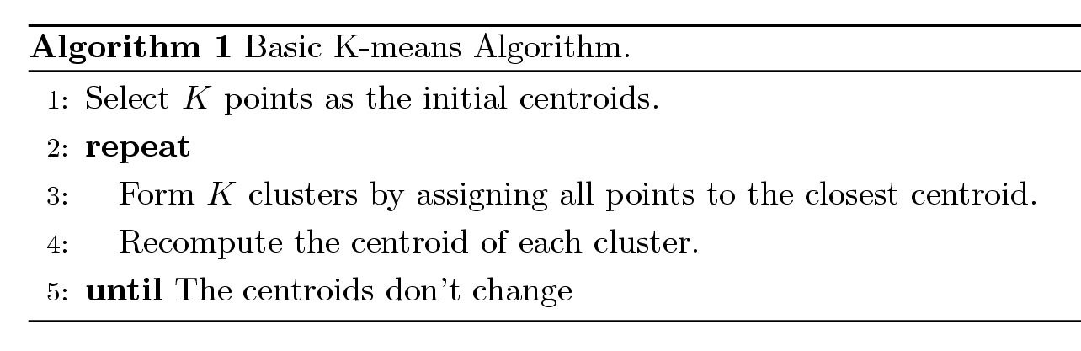
K-means Clustering
Partitional clustering approach
Each cluster is associated with a centroid (center point)
Each point is assigned to the cluster with the closest centroid
Number of clusters, K, must be specified
The basic algorithm is very simple

Slide 25
K-means Example
For simplicity, 1-dimension objects and k=2.
Numerical difference is used as the distance
Objects: 1, 2, 5, 6,7
K-means:
Randomly select 5 and 6 as centroids;
=> Two clusters {1,2,5} and {6,7}; meanC1=8/3, meanC2=6.5
=> {1,2}, {5,6,7}; meanC1=1.5, meanC2=6
=> no change.
Aggregate dissimilarity
(sum of squares of distance each point of each cluster from its cluster center--(intra-cluster distance)
= 0.5²+ 0.5²+ 1²+ 0²+1² = 2.5
|1-1.5|²

Slide 26
K-Means Example
Given: {2,4,10,12,3,20,30,11,25}, k=2
Randomly assign means: m₁=3,m₂=4
K₁={2,3}, K₂={4,10,12,20,30,11,25}, m₁=2.5,m₂=16
K₁={2,3,4},K₂={10,12,20,30,11,25}, m₁=3,m₂=18
K₁={2,3,4,10},K₂={12,20,30,11,25}, m₁=4.75,m₂=19.6
K₁={2,3,4,10,11,12},K₂={20,30,25}, m₁=7,m₂=25
Stop as the clusters with these means are the same.

Slide 27
K Means Example (K=2)
Pick seeds
Reassign clusters
Compute centroids
Reasssign clusters
x
x
x
Compute centroids
x
x
x
Reassign clusters
Converged!
[From Mooney]

Slide 28
K-means Clustering – Details
Initial centroids are often chosen randomly.
Clusters produced vary from one run to another.
The centroid is (typically) the mean of the points in the cluster.
‘Closeness’ is measured by Euclidean distance, cosine similarity, correlation, etc.
K-means will converge for common similarity measures mentioned above.
Most of the convergence happens in the first few iterations.
Often the stopping condition is changed to ‘Until relatively few points change clusters’
Complexity is O( n * K * I * d )
n = number of points, K = number of clusters, I = number of iterations, d = number of attributes

Slide 29
Evaluating K-means Clusters
Most common measure is Sum of Squared Error (SSE)
For each point, the error is the distance to the nearest cluster
To get SSE, we square these errors and sum them.
x is a data point in cluster C_{i} and m_{i} is the representative point for cluster C_{i}
can show that m_{i} corresponds to the center (mean) of the cluster
Given two clusters, we can choose the one with the smallest error
One easy way to reduce SSE is to increase K, the number of clusters
A good clustering with smaller K can have a lower SSE than a poor clustering with higher K

Slide 30
Two different K-means Clusterings
Original Points
Optimal Clustering
Sub-optimal Clustering

Slide 31
Importance of Choosing Initial Centroids

Slide 32
Importance of Choosing Initial Centroids

Slide 33
Importance of Choosing Initial Centroids …

Slide 34
Importance of Choosing Initial Centroids …

Slide 35
Good Initial Centroids
Source of figure: Introduction to Data Mining by Tan et. al.

Slide 36
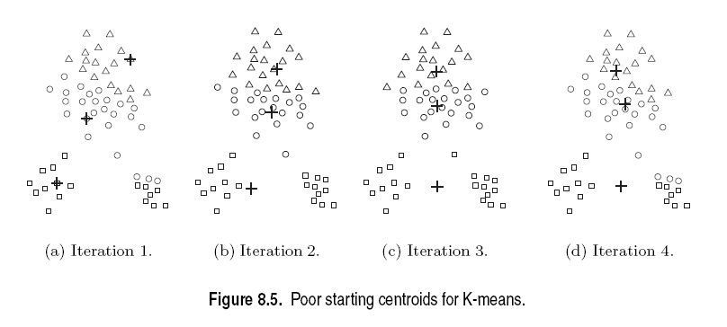
Poor Initial Centroids
Source of figure: Introduction to Data Mining by Tan et. al.

Slide 37
Pros & Cons of K-means
Relatively efficient: O(tknd)
n: # objects, k: # clusters, t: # iterations; n:# attributes k, t << n.
Applicable only when mean is defined
What about categorical data?
Need to specify the number of clusters
Unable to handle noisy data and outliers

Slide 38
Limitations of K-means
K-means has problems when clusters are of differing
Sizes
Densities
Non-globular shapes
Empty clusters
K-means has problems when the data contains outliers.

